Slide 1



SLIDE
Mastering in JS Object
PROGRAMMING HERO

Slide 2


Compare object, referential integrity
JavaScript call(), apply() and bind() Methods
this keyword in JavaScript

Slide 3


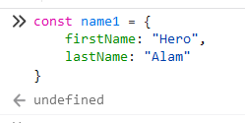
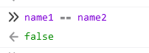
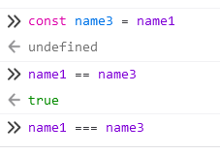
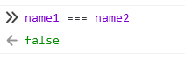
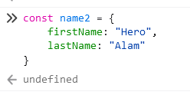

Compare object, referential integrity

Slide 4

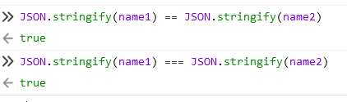
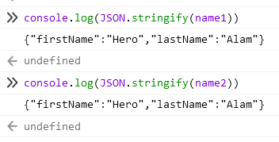
Compare object, referential integrity

Slide 5

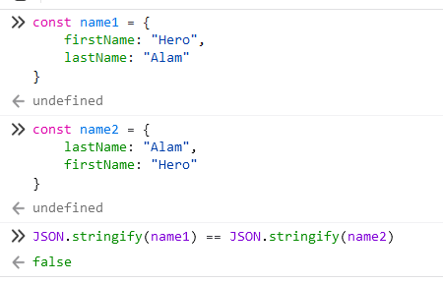
Compare object, referential integrity
The order of object properties is important

Slide 6
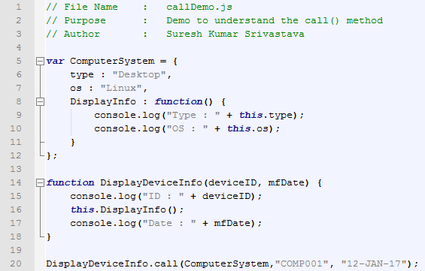

JavaScript call(), apply() and bind() Methods
call()
call() method in JavaScript is used to invoke the function, it will pass an object as first parameter which will be the value of this inside function.
Ref: coursegalaxy.com

Slide 7
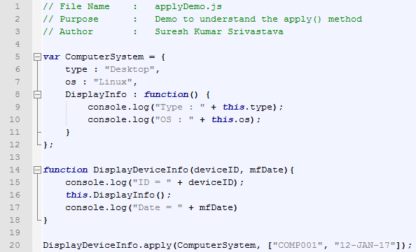
JavaScript call(), apply() and bind() Methods
apply()
apply() method in JavaScript is same as call(). It is used to invoke the function but the parameters will be passed in array. This may be very useful in scenarios where we get the input in form of array or we have to pass variable number of arguments.
Ref: coursegalaxy.com

Slide 8
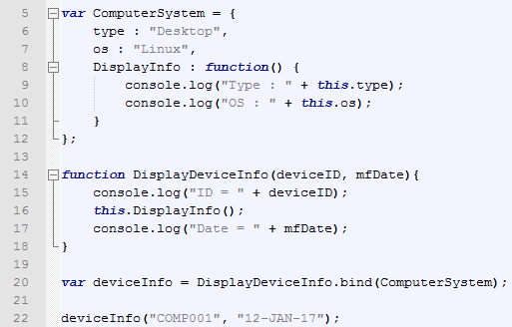
JavaScript call(), apply() and bind() Methods
bind()
bind() method in JavaScript is used to create new function, it will pass an object as parameter which will be the value of this inside function.
Ref: coursegalaxy.com

Slide 9
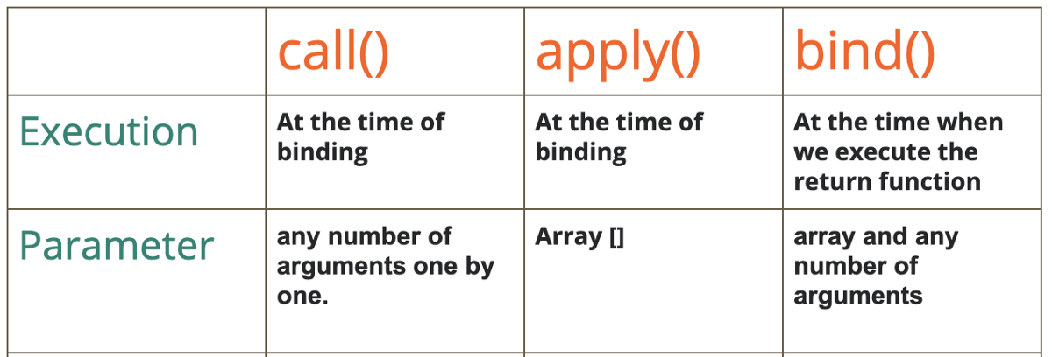
JavaScript call(), apply() and bind() Methods

Slide 10
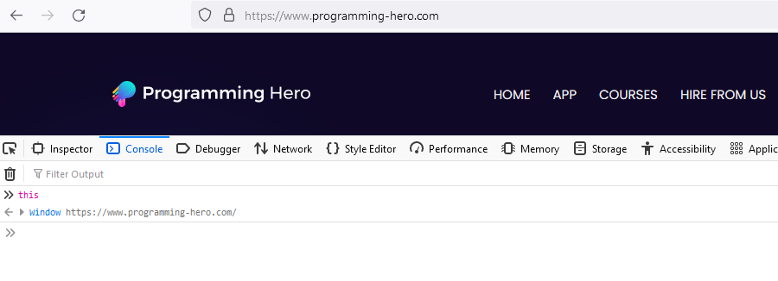
this keyword alone

Slide 11
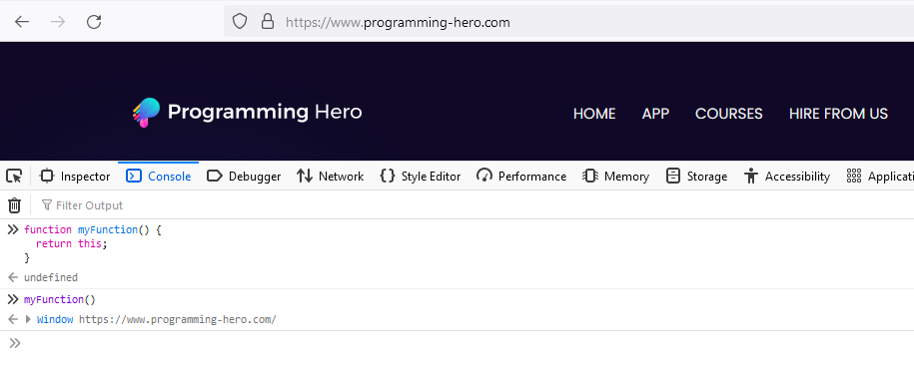
this keyword in a function

Slide 12
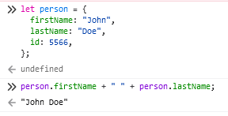
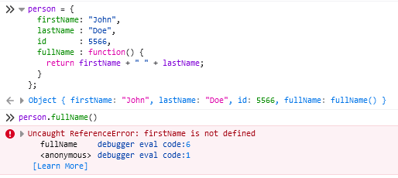
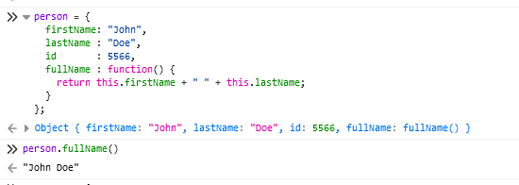
this keyword in a object method binding
1
2
3

Slide 13
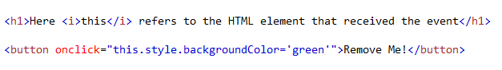

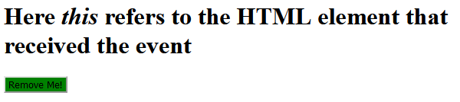
this keyword in event handlers
before button click
after button click

Slide 14
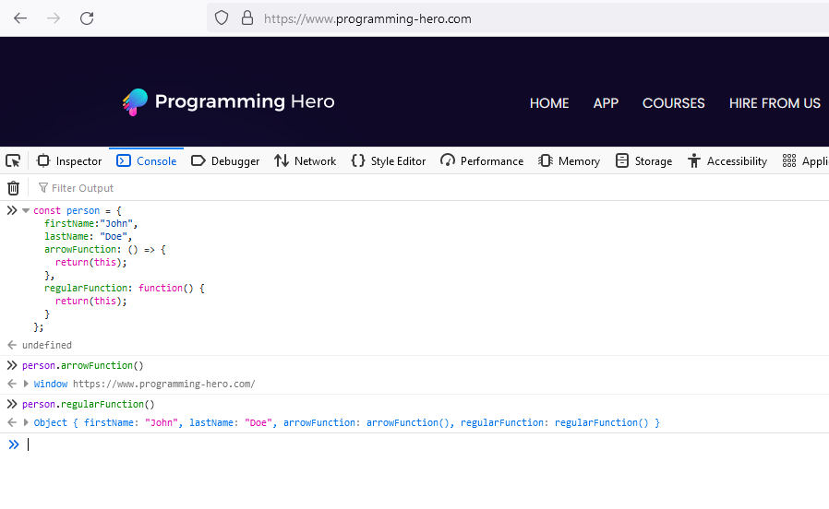
this keyword in (regular function VS arrow function)

Slide 15
So, what is “this” in JS?
In JavaScript, the this keyword refers to an object, it’s not any variable. We can not change the value of it. Which object depends on how this is being invoked (used or called).
The this keyword refers to different objects depending on how it is used:
In an object method, this refers to the object.
Alone, this refers to the global object.
In a function, this refers to the global object.
In an event, this refers to the element that received the event.
Methods like call(), apply(), and bind() can refer this to any object.
Ref: w3schools.com

Slide 16


Go ahead!
PROGRAMMING HERO

